Slide 1
MBA Student Investment Management Fund
Semi-Annual Presentation
December 2022
MBA Student Investment Management Fund
Arizona State University

Slide 2
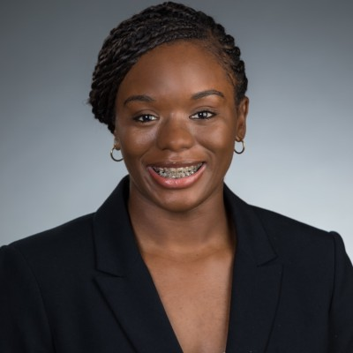
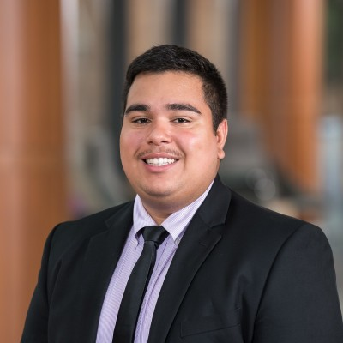
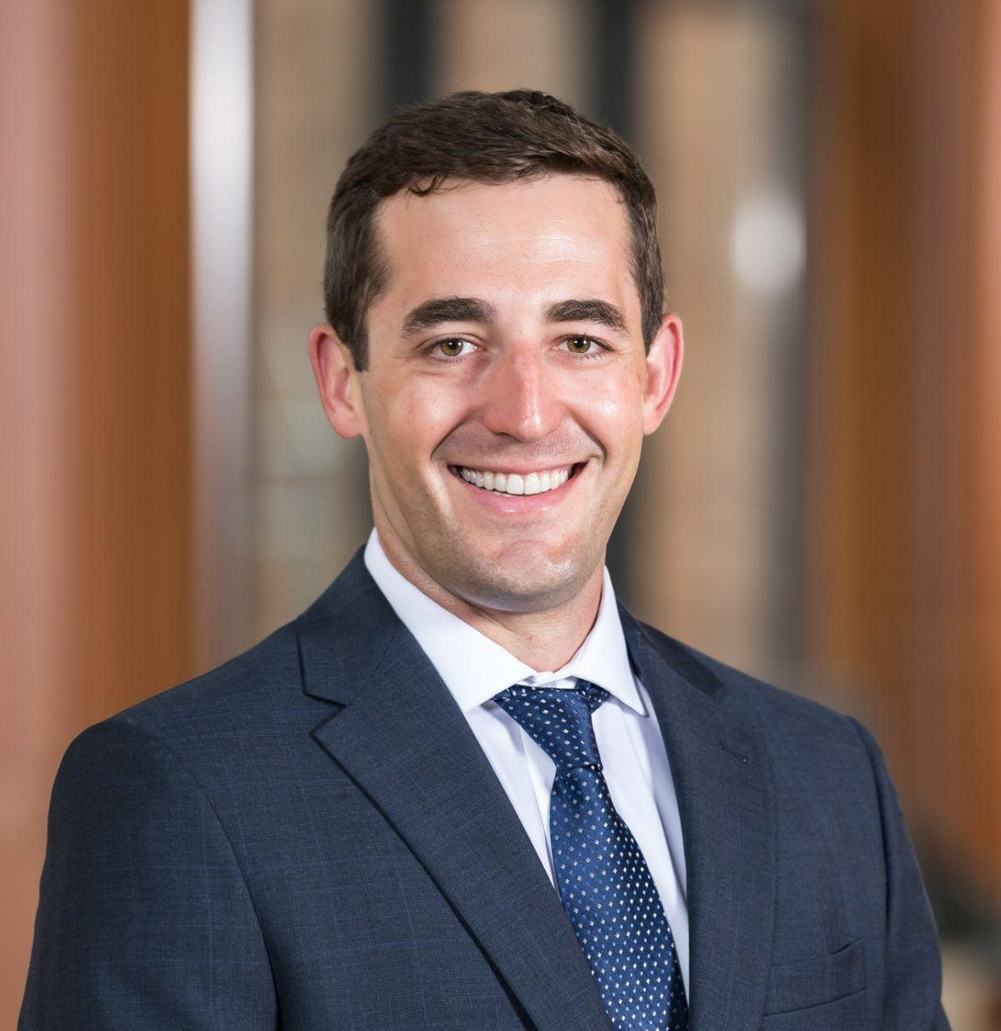
MBA SIM Fund Team
Alex Arnon
Camille Bryant
Rita Leal
Dan Manson
Sebastian Pacheco
Mike Shufeldt
Jenna Zuberi
MBA Student Investment Management Fund
Arizona State University
‹#›

Slide 3
Table of Contents
I. Investment Thesis
II. Portfolio
III. Monitoring & Rebalancing
MBA Student Investment Management Fund
Arizona State University
‹#›

Slide 4
Investment Thesis
MBA Student Investment Management Fund
Arizona State University
Notes:
Talk about how we were given some papers to read, but there were some flaws with them

Slide 5
“The book-to-market ratio has been widely used to explain the cross-sectional variation in stock returns, but the explanatory power is weaker in recent decades than in the 1970s.”
Park (2019)
MBA Student Investment Management Fund
Arizona State University
‹#›

Slide 6
Book-to-Market did perform very well!
Book-to-Market Decile Analysis, January 1, 1967, to December 31, 1984
Decile | Annual Compound Return | Annual Outperformance | Standard Deviation | Sharpe Ratio
1 (highest B/M) | 16.60% | 5.43% | 20.69% | 0.56
2 | 16.35% | 5.18% | 18.33% | 0.62
3 | 14.19% | 3.02% | 17.15% | 0.54
4 | 12.08% | 0.91% | 17.53% | 0.40
5 | 10.92% | (0.25%) | 18.40% | 0.32
6 | 10.75% | (0.42%) | 19.17% | 0.30
7 | 9.05% | (2.12%) | 19.68% | 0.21
8 | 7.29% | (3.88%) | 20.76% | 0.11
9 | 6.54% | (4.63%) | 21.87% | 0.07
10 (lowest B/M) | 6.90% | (4.27%) | 24.47% | 0.08
Market | 11.17% | 0.00% | 19.29% | 0.32
O’Shaughnessy, 2012
MBA Student Investment Management Fund
Arizona State University
‹#›

Slide 7
But was that just an outlier?
Average Annual Compound Rates of Return by Decade
 | 1930s | 1940s | 1950s | 1960s | 1970s | 1980s | 1990s | 2000s
Book-to-Market Decile 1 | (10.97%) | 17.34% | 18.53% | 11.34% | 13.29% | 21.25% | 14.68% | 9.12%
All Stocks | (0.03%) | 11.57% | 18.07% | 10.72% | 7.56% | 16.78% | 15.35% | 4.39%
Value Outperformance | (10.94%) | 5.77% | 0.46% | 0.62% | 5.43% | 4.47% | (0.67%) | 4.73%
O’Shaughnessy, 2012
MBA Student Investment Management Fund
Arizona State University
‹#›

Slide 8
“We addressed the important issue of mismeasurement of value because of a core failing of book value as a valuation metric. This classic measure of value was designed at a time when the economy was much less reliant on intellectual property and other intangibles.”
Arnott et al (2021)
MBA Student Investment Management Fund
Arizona State University
‹#›

Slide 9
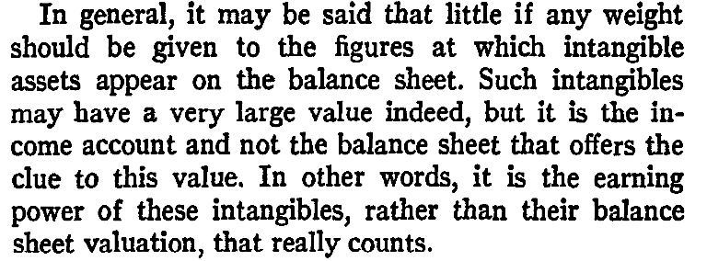
Graham (1937)
MBA Student Investment Management Fund
Arizona State University
‹#›

Slide 10
So why not go straight to earnings?
Average Annual Compound Rates of Return by Decade
 | 1960s | 1970s | 1980s | 1990s | 2000s
Earnings-to-Price Decile 1 | 17.68% | 13.03% | 20.38% | 16.02% | 14.86%
Book-to-Market Decile 1 | 11.34% | 13.29% | 21.25% | 14.68% | 9.12%
All Stocks | 13.36% | 7.56% | 16.78% | 15.35% | 4.39%
E/P Outperformance | 4.32% | 5.47% | 3.60% | 0.67% | 10.47%
O’Shaughnessy, 2012
MBA Student Investment Management Fund
Arizona State University
‹#›

Slide 11
But what about cash-based earnings?
 | 2021 | 2020 | 2019 | 2018 | 2017 | Sum
Net Income (in Millions) | $5,116.23 | $2,761.40 | $1,866.92 | $1,211.24 | $558.93 | $11,514.71
FCF (in Millions) | ($131.98) | $1,929.15 | ($3,140.36) | ($2,893.01) | ($2,012.97) | ($6,249.16)
MBA Student Investment Management Fund
Arizona State University
‹#›

Slide 12
Free Cash Flow-to-Price
Average Annual Compound Rates of Return by Decade
 | 1960s | 1970s | 1980s | 1990s | 2000s
FCF-to-Price Decile 1 | 15.86% | 13.64% | 19.27% | 16.62% | 15.78%
Earnings-to-Price Decile 1 | 17.68% | 13.03% | 20.83% | 16.02% | 14.86%
Book-to-Market Decile 1 | 11.34% | 13.29% | 21.25% | 14.68% | 9.12%
All Stocks | 13.36% | 7.56% | 16.78% | 15.35% | 4.39%
FCF/P Outperformance | 2.50% | 6.08% | 2.49% | 1.27% | 11.39%
O’Shaughnessy, 2012
MBA Student Investment Management Fund
Arizona State University
‹#›
Notes:
But further research showed there to be an even better factor…

Slide 13
EBITDA-to-EV
Average Annual Compound Rates of Return by Decade
 | 1960s | 1970s | 1980s | 1990s | 2000s
EBITDA-to-EV Decile 1 | 14.14% | 13.82% | 19.95% | 18.59% | 15.55%
FCF-to-Price Decile 1 | 15.86% | 13.64% | 19.27% | 16.62% | 15.78%
Earnings-to-Price Decile 1 | 17.68% | 13.03% | 20.38% | 16.02% | 14.86%
Book-to-Market Decile 1 | 11.34% | 13.29% | 21.25% | 14.68% | 9.12%
All Stocks | 13.36% | 7.56% | 16.78% | 15.35% | 4.39%
EBITDA/EV Outperformance | 0.78% | 6.26% | 3.17% | 3.24% | 11.16%
O’Shaughnessy, 2012
MBA Student Investment Management Fund
Arizona State University
‹#›
Notes:
But it still gets outperformed within decades…

Slide 14
But combining them has the best results of all!
Average Annual Compound Rates of Return by Decade
 | 1960s | 1970s | 1980s | 1990s | 2000s
Combined Metric Decile 1 | 16.84% | 14.78% | 22.21% | 16.34% | 15.73%
EBITDA-to-EV Decile 1 | 14.14% | 13.82% | 19.95% | 18.59% | 15.55%
NOCF-to-Price Decile 1 | 15.86% | 13.64% | 19.27% | 16.62% | 15.78%
Earnings-to-Price Decile 1 | 17.68% | 13.03% | 20.38% | 16.02% | 14.86%
Book-to-Market | 11.34% | 13.29% | 21.25% | 14.68% | 9.12%
All Stocks | 13.36% | 7.56% | 16.78% | 15.35% | 4.39%
Combined Metric Outperformance | 3.48% | 7.22% | 5.43% | 0.99% | 11.34%
O’Shaughnessy, 2012
MBA Student Investment Management Fund
Arizona State University
‹#›

Slide 15
Our Strategy
Name | E/P Rank | FCF/P Rank | EBITDA/EV Rank | B/P Rank | Score | Rank
UNITED STATES STEEL CORP | 9 | 20 | 3 | 16 | 48 | 1
EAGLE BULK SHIPPING INC | 18 | 37 | 22 | 154 | 231 | 2
MR COOPER GROUP INC | 37 | 2 | 184 | 8 | 231 | 3
LUMEN TECHNOLOGIES INC | 44 | 42 | 124 | 28 | 238 | 4
RESOLUTE FOREST PRODUCTS | 72 | 54 | 31 | 86 | 243 | 5
TAYLOR MORRISON HOME CORP | 45 | 58 | 83 | 63 | 249 | 6
GENCO SHIPPING & TRADING LTD | 38 | 139 | 27 | 54 | 258 | 7
FULGENT GENETICS INC | 78 | 77 | 1 | 128 | 284 | 8
LAREDO PETROLEUM INC | 7 | 50 | 13 | 229 | 299 | 9
BERRY CORP | 67 | 78 | 24 | 144 | 313 | 10
MBA Student Investment Management Fund
Arizona State University
‹#›
Notes:
Talk about what our final strategy is; talk about what this table means; talk about how the portfolio is equally weighted and we tried other schemes; talk about pulling data from Bloomberg + Python scripts

Slide 16
Portfolio
MBA Student Investment Management Fund
Arizona State University

Slide 17
Portfolio Seeding
Python script for sector weight (+/- 7.5% off Russell 3000)
News Checks (Per person by sector)
Update 50 Securities
Equal Weight Seeding (2% per security)
MBA Student Investment Management Fund
Arizona State University
‹#›
Notes:
Implementation - Mike
This is the portfolio
If unconstrained, how would we have built it?
No mkt cap constraints, top 50 ranked – Sample portfolio w/ no constraints (top 50, diversify idiosyncratic risk)
We are constrained – audience heard about it from other teams – here’s what we did to build around those constraints
Put up final product of comparative metrics (ours versus unconstrained)
2-weeks of returns (vs russel 3000)
Future: tracking, rebalancing, etc

Slide 18
Portfolio Breakdown
50 Securities
Average Mkt Cap:
$8.65B
Current Portfolio
Aligned w/ Russell 3000 Sector Weights
Sectors
Under/Overweight Sectors
MBA Student Investment Management Fund
Arizona State University
‹#›
Notes:
Implementation - Mike
This is the portfolio
If unconstrained, how would we have built it?
No mkt cap constraints, top 50 ranked – Sample portfolio w/ no constraints (top 50, diversify idiosyncratic risk)
We are constrained – audience heard about it from other teams – here’s what we did to build around those constraints
Put up final product of comparative metrics (ours versus unconstrained)
2-weeks of returns (vs russel 3000)
Future: tracking, rebalancing, etc

Slide 19
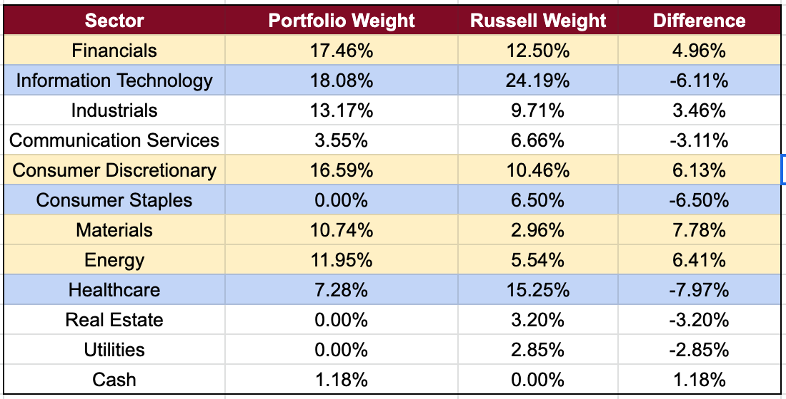
Portfolio Breakdown
Sector Weighting Analysis
MBA Student Investment Management Fund
Arizona State University
‹#›
Notes:
Implementation - Mike
This is the portfolio
If unconstrained, how would we have built it?
No mkt cap constraints, top 50 ranked – Sample portfolio w/ no constraints (top 50, diversify idiosyncratic risk)
We are constrained – audience heard about it from other teams – here’s what we did to build around those constraints
Put up final product of comparative metrics (ours versus unconstrained)
2-weeks of returns (vs russel 3000)
Future: tracking, rebalancing, etc

Slide 20
Comparative Metrics
Portfolio vs. Ex-Portfolio vs. Bootstrap (1000)
MBA Student Investment Management Fund
Arizona State University
‹#›

Slide 21
Sector Agnostic ‘Shadow’ Portfolio
Portfolio Breakdown
Same Universe (Mkt Cap > $600M)
Top 50 Ranked Securities
No Cash Holdings
MBA Student Investment Management Fund
Arizona State University
‹#›
Notes:
Implementation - Mike
This is the portfolio
If unconstrained, how would we have built it?
No mkt cap constraints, top 50 ranked – Sample portfolio w/ no constraints (top 50, diversify idiosyncratic risk)
We are constrained – audience heard about it from other teams – here’s what we did to build around those constraints
Put up final product of comparative metrics (ours versus unconstrained)
2-weeks of returns (vs russel 3000)
Future: tracking, rebalancing, etc

Slide 22
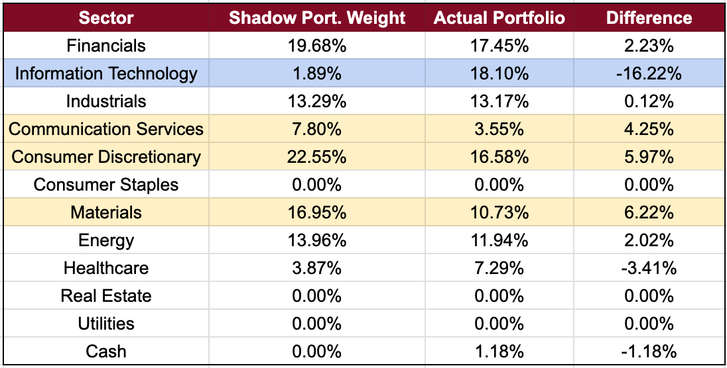
Sector Agnostic ‘Shadow’ Portfolio
Sector Analysis (vs. our Portfolio)
MBA Student Investment Management Fund
Arizona State University
‹#›
Notes:
Implementation - Mike
This is the portfolio
If unconstrained, how would we have built it?
No mkt cap constraints, top 50 ranked – Sample portfolio w/ no constraints (top 50, diversify idiosyncratic risk)
We are constrained – audience heard about it from other teams – here’s what we did to build around those constraints
Put up final product of comparative metrics (ours versus unconstrained)
2-weeks of returns (vs russel 3000)
Future: tracking, rebalancing, etc

Slide 23
Returns (3-weeks, no rebalances)
MBA Student Investment Management Fund
Arizona State University
‹#›
Notes:
Implementation - Mike
This is the portfolio
If unconstrained, how would we have built it?
No sector constraints, top 50 ranked – Sample portfolio w/ no constraints (top 50, diversify idiosyncratic risk)
We are constrained – audience heard about it from other teams – here’s what we did to build around those constraints
Put up final product of comparative metrics (ours versus unconstrained)
2-weeks of returns (vs russel 3000)
Future: tracking, rebalancing, etc

Slide 24
Monitoring & Rebalancing
MBA Student Investment Management Fund
Arizona State University

Slide 25
Monitoring Processes
Example News Sources:
Bloomberg
WSJ
Forbes
Business Insider
Google Alerts News Tracking - Daily
‘Live’ Google Sheet Tracking Returns
Update Portfolio
Keywords
Example Keywords:
Merger
Acquisition
Fraud
Litigation
Validate News Source
MBA Student Investment Management Fund
Arizona State University
‹#›

Slide 26
Rebalancing Plan
Pull/ Organize Data
Avoid ‘Trigger’ Companies
Pull updated financial data from Bloomberg. Re-rank universe IAW investment criteria.
Execute Rebalance
Rebalance Accordingly
Team will validate new potential securities as described in ‘monitoring plan’ on previous slide.
Rebalance the portfolio using the guide rails described below.
Monthly Rebalances
Goal: Minimize Transaction Costs
Considerations:
Individual Weights (+/- 2%)
Sector Weights (+/- 7.5%)
Large Rank Changes
MBA Student Investment Management Fund
Arizona State University
‹#›

Slide 27
Thank You!
Questions?
MBA Student Investment Management Fund
Arizona State University

Slide 28
Appendix
Data Dictionary
CapEx
Bloomberg Function: TRAIL_12M_CAP_EXPEND - Calculated by adding Capital Expenditures from the statement of cash flows for the last four quarters, two semi annuals, or annual.
OCF (in M)
Bloomberg Function: TRAIL_12M_CASH_FROM_OPER - Calculated by adding cash from operations from the statement of cash flows for the last four quarters, two semi annuals, or annual.
Manual FCF
Manually calculated as CapEx (in M) + OCF (in M)
BBG FCF
Bloomberg Function: TRAIL_12M_FREE_CASH_FLOW - Calculated by adding Free Cash Flow for the last four quarters, two semi-annuals, or annual.
MBA Student Investment Management Fund
Arizona State University

Slide 29
Appendix
Data Dictionary - Continued
Current Shares Outstanding
Function in Bloomberg: BS_SH_OUT - All of the shares of a corporation that have been authorized, issued, purchased, and held by investors as of period end date.
Current Shares Price
Bloomberg Function: PX_LAST - Last price for the security
True Current Cap
Manually calculated as current shares outstanding X current share price
TTM_EPS
Bloomberg Function: TRAIL_12M_EPS - Sum of the most recent 12 months, four quarters, two semi annuals, or annual earnings per share (EPS)
Manual P/E
Manually calculated as current share price/TTM EPS
BBG P/E
Bloomberg Function: PE_RATIO - Ratio of the price of a stock and the company’s earnings per share.
MBA Student Investment Management Fund
Arizona State University

Slide 30
Appendix
Data Dictionary - Continued
Manual FCF/P
Manually calculated as (Manual FCF * 1000000)/True Current Cap
BBG FCF/P
Bloomberg Function: PX_TO_FREE_CASH_FLOW - Valuation metric that compares a company’s market price to its level of training 12 month free cash flow per share. Calculated as Last Price / Trailing 12 Month FCF Per Share
TTM EBITDA (In M)
Bloomberg Function: TRAIL_12M_EBITDA - Calculated by adding EBITDA for the last four quarters, two semi annuals, or annual as determined by Primary Periodicity.
Current EV (in M)
Bloomberg Function: CURR_ENTP_VAL - Calculated as Market Capitalization + EV Components
Manual EBITDA/EV
Manually calculated as TTM EBITDA/Current EV
MBA Student Investment Management Fund
Arizona State University

Slide 31
Appendix
Data Dictionary - Continued
BBG EBITDA/EV
Bloomberg Function: CURRENT_EV_TO_T12M_EBITDA - Enterprise value as a percentage of trailing 12 month earnings before interest, taxes, depreciation, and amortization (EBITDA). Calculate as Current Enterprise Value / (Trailing 12 Month EBITDA+EBITDA Annualization Transition Adjustment for Operating Lease)
Book PS
Bloomberg Function: BOOK_VAL_PER_SH - Measured used by owners of common shares in a firm to determine the level of safety associated with each individual share after all debts are paid accordingly. Units: Actual Calculated as Total Common Equity / Number of Shares Outstanding
Manual P/B
Manually calculated as Current Share Price/Book PS
BBG P/B
Bloomberg Function: MARKET_CAPITALIZATION_TO_BV - Measure of the relative value of a company compared to its market value. Unit: Actual. Calculated as Market Capitalization / Book Value
MBA Student Investment Management Fund
Arizona State University

