Slide 1
WPC MBA SIM Fund
April 26, 2013
Semi-Annual Board Update

Slide 2
Agenda
Introduction
Fund Objective
General Strategy: Asset Allocation
Discussions on Rebalancing
Other Positions
Active Strategy: Global Momentum
Performance and Final Thoughts

Slide 3
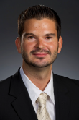
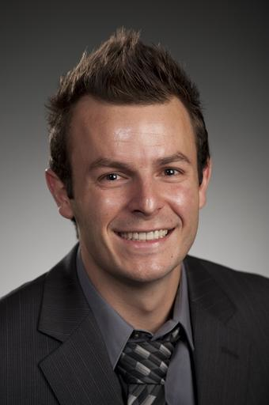
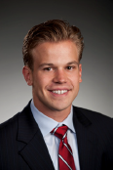
2012 – 2013 SIM Fund Team
Paul Balskus
Martin Brcka
John Good
Kris Kaminski
Chris Pettit
Portfolio Manager
Colin Porter
Eric Williams
Joe Zanck

Slide 4
Fund Objectives
Manage approximately $560,000 of the Arizona State Foundation
Applying the MBA program’s teachings on fundamental analysis, portfolio management, and fund administration
Track portfolio’s performance and continue to look for attractive investment opportunities
Achieve positive returns relative to benchmarks

Slide 5
Research on Asset Allocation
CFA Institute Whitepaper
Asset Allocation vs. Security Selection: Their Relative Importance
The Importance of Asset Allocation
by Roger G. Ibbotson
Notes:
Put this in contact. “Last time there was discussion about asset allocation…”

Slide 6
Asset Allocation Methodology
Reviewed average asset allocations for two types of institutional investors
NCSE study of 823 endowments as of June 2011
Pension & Investments Top 1000 retirement funds as of December 2011
Reasons for looking at these institutional average asset allocations
Long-term outlook
SIM Fund is part of ASU Foundation Fund
Notes:
You may recall from December…

Slide 7
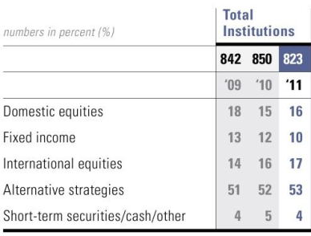
Average Asset Allocations
NCSE 2011 Report
P&I Online Top 1000 Funds
Source: Pension & Investments Online – February 6, 2012
Source: 2011 NACUBO-Commonfund Study of Endowment Results
Notes:
Tilt because, small endowments have a hard time investing in hedge funds. Also liquidity issues

Slide 8
MBA Portfolio Allocation: Oct -Jan

Slide 9
MBA Portfolio Allocation: Jan - April
Notes:
Need to update this chart.

Slide 10
January Rebalancing Discussions
Fixed Income
Commodities: Investment in oil?
To Sell or not to Sell
Turkey and other country ETFs

Slide 11
Global Momentum Strategy
Expanded the momentum strategy to pursue the top performing countries out of the 45 countries as indicated by the ACWI Ex US Index
Rank the t-12 to t-2 MSCI index returns for each of the 45 countries in the index
Equally allocate our 20% across the top five momentum countries

Slide 12
Country Allocation (November-January)
Thailand
Philippines
Belgium
Denmark
New Zealand
Turkey
Mexico

Slide 13
Country Allocation (February-Present)
Turkey
Philippines
Thailand
Belgium
New Zealand
Ireland
Denmark
Mexico

Slide 14
Global Momentum vs. ACWI Ex-US Index (11/20/2012-04/25/2013)

Slide 15
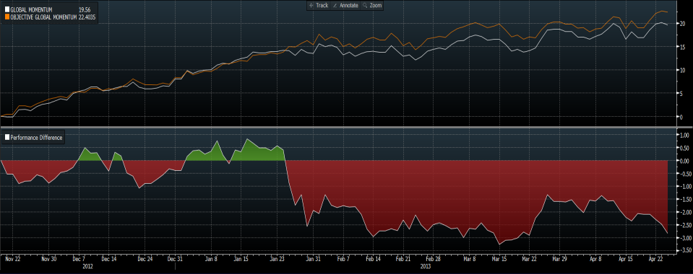
Global Momentum vs. Unconstrained Portfolio (11/20/2012-04/25/2013)
Notes:
Need Update

Slide 16
Global Momentum vs. Emerging Markets (11/20/2012-04/25/2013)

Slide 17
Global Momentum Portfolio Statistics (11/20/2012-04/25/2013)

Slide 18
US Equities – 60%
US Equity Core – 30%
Vanguard Total Stock Market (VTI)
Sector Overweight - 5% Each
Vanguard Sector ETFs
VFH – Financials
VHT – Healthcare
VGT – Information Technology
Small Cap Overweight – 15%
Vanguard Small Cap Index ETF (VB)
Notes:
All Vanguard Funds have low relative expense ratios
Security: Vanguard Total Stock Market (VTI)
Description:
3,000 stocks representative of the whole U.S. market
Goal is to keep pace with U.S. stock market returns
Fund total net assets: $201.4 billion
Reasons for Investing:
Diversification
Expense ratio: 0.06% which is 95% lower than the average expense ratio of funds with similar holdings
Net assets of ten largest holdings: 16.9%

Slide 19
US Technology Sector vs. Russell 3000 (11/20/2012-04/25/2013)
Notes:
Applications penetrating new territory and devices become interconnected
Cloud computing
Compressed valuations and strong prospects for an earnings rebound
Growth in business investment in technology is now outpacing growth in total business investment
Security: Vanguard Technology ETF (VGT)
Investment Amount: 5% of Fund
Description:
Passively Managed
Seeks to track the performance of a benchmark index that measures the investment return of stocks in the Technology sector
Number of stocks: 410
Fund total net assets: $2.5 billion
Don’t mention, unless asked - Net assets of ten largest holdings: 60.4% (Top 10:
88% lower than the average expense ratio of funds with similar holdings

Slide 20
US Healthcare Sector vs. Russell 3000 (11/20/2012-04/25/2013)
Notes:
Healthcare investment opportunities throughout this decade
Expansion of Medicare and Medicaid
17% of US GDP, and could rise to 20% of US GDP by 2018 CMMS
Balance sheets in the health-care sector remain flush with cash
Aging population and rising obesity rates
CMMS – Center for M
Security: Vanguard Healthcare ETF (VHT)
Investment Amount: 5% of Fund
Description:
Passively Managed
Seeks to track the performance of a benchmark index that measures the investment return of stocks in the Healthcare sector
Number of stocks: 293
Fund total net assets: $1.1 billion
Do not say unless asked - Net assets of ten largest holdings: 52.3% ( 10 holdings are J&J, Pfizer, AmGen,
88% lower than the average expense ratio of funds with similar holdings.

Slide 21
US Financial Sector vs. Russell 3000 (11/20/2012-04/25/2013)
Notes:
CMMS – Center for M
Anticipate questions about components of healthcare.
Security: Vanguard Healthcare ETF (VHT)
Investment Amount: 5% of Fund
Description:
Passively Managed
Seeks to track the performance of a benchmark index that measures the investment return of stocks in the Healthcare sector
Number of stocks: 293
Fund total net assets: $1.1 billion
Do not say unless asked - Net assets of ten largest holdings: 52.3% ( 10 holdings are J&J, Pfizer, AmGen,
88% lower than the average expense ratio of funds with similar holdings.

Slide 22
US Small Cap Equity vs. Russell 3000 (11/20/2012-04/25/2013)
Notes:
Historically have produced higher returns than large cap
Diversified small-cap fund
Accommodative Fed
Delinquent loan estimates have decreased
Businesses are starting to increase borrowing

Slide 23
Real Estate vs. Russell 3000 (11/20/2012-04/25/2013)
Notes:
Diversification benefit
Real estate prices are recovering
Investment: VGRSX - Vanguard REIT Index Fund Signal Shares
Expense Ratio: 0.10%
Passively managed fully replicating
Turnover Rate: 9.80%
Low correlation with other investments

Slide 24
Benchmarking
Benchmark our returns against the Russell 3000 and a custom benchmark of the following:

Slide 25
Total Portfolio Vs. Russell 3000 (11/20/2012-04/25/2013)

Slide 26
Total Fund Performance (11/20/2012-04/25/2013)

Slide 27
Recommendations
International Equity
Increase allocation allowance to 40%
Better representation of the world economy
MSCI World Index (USD)

Slide 28
Appendix

Slide 29
Total Portfolio Heat Map 11/20/12 – 4/24/13

Slide 30
Total Portfolio Statistics 11/20/12 – 4/24/13

Slide 31
Vanguard Total Stock Market ETF (VTI)

Slide 32
Vanguard Small-Cap ETF (VB)

Slide 33
Vanguard Financials ETF (VFH)

Slide 34
Vanguard Health Care ETF (VHT)

Slide 35
Vanguard Information Technology ETF (VGT)

Slide 36
MSCI Thailand Investable Market Index Fund

Slide 37
MSCI Philippines Investable Market Index Fund

Slide 38
MSCI New Zealand Investable Market Index Fund

Slide 39
MSCI Turkey Investable Market Index Fund

Slide 40
MSCI Mexico Investable Market Index Fund

Slide 41
Vanguard REIT Index Fund Signal Shares (VGRSX)

Slide 42
Vanguard Intermediate-Term Investment-Grade Fund Admiral Shares (VFIDX)
Notes:
Don't need this?

