Slide 1

MBA SIM Fund
Board Presentation
April 30, 2010

Slide 2
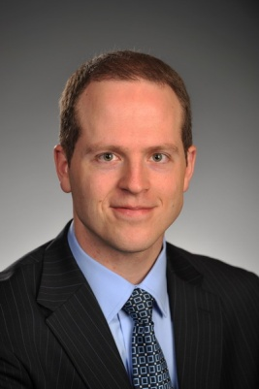


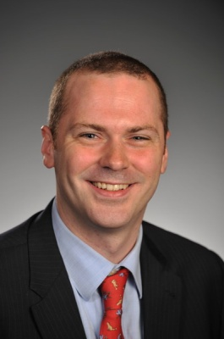
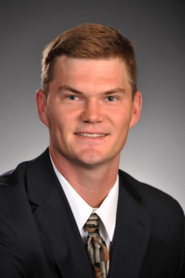

2009-2010 Student Managers
Spencer Rands
W.P. Carey MBA
Finance & Real Estate
Class of 2010
Himanshu Gupta
W.P. Carey MBA
Supply Chain Finance
Class of 2010
Perrin Gayle
W.P. Carey MBA
Finance
Class of 2010
Andrew Harbut
W.P. Carey MBA
Finance
Class of 2010
Eric Dalbom
W.P. Carey MBA
Finance & Real Estate
Class of 2010
Matt Pendleton
W.P. Carey MBA
Finance
Class of 2010
2
Notes:
CIS 512CIS 512
August 26, 2003Monday, November 08, 1999
Copyright - Ajay Vinze 2003©Ajay Vinze
2

Slide 3
Agenda
Overview
Portfolio Performance
Economic Climate & Outlook
Portfolio Highlights
Attribution Analysis
Takeaways
Notes:
CIS 512CIS 512
August 26, 2003Monday, November 08, 1999
Copyright - Ajay Vinze 2003©Ajay Vinze
3

Slide 4
Overview

Slide 5
Fund Guidelines
Long-term investment strategy
Minimum 75% equities
Maximum 20% fixed income
Maximum 10% cash
$500MM minimum market cap
No short selling
Limits on derivatives

Slide 6
Style Selection
Style: Midcap Growth
  Market Cap: $2b - $10b
Benchmark
  Russell Midcap Growth Index (RDG)
Asset Allocation
  Equities: 92%
  Fixed Income: 5%
  Cash: 3%

Slide 7
Portfolio Analysis
Notes:
CIS 512CIS 512
August 26, 2003Monday, November 08, 1999
Copyright - Ajay Vinze 2003©Ajay Vinze
7

Slide 8
Fund Characteristics
 | SIM Fund | Russell Midcap Growth
Market Cap ($B) | 6,465.35 | 7,262.96
Dividend Yield | 0.90 | 0.98
Trailing P/E | 17.52 | 31.38
Forward P/E | 15.17 | 21.39
ROA | 12.33 | 7.84
ROE | 25.93 | 16.68
Notes:
CIS 512CIS 512
August 26, 2003Monday, November 08, 1999
Copyright - Ajay Vinze 2003Ajay Vinze
8

Slide 9
Fund Performance
Spring Results: 11/20/09 – 4/16/10
4/16 Portfolio Value
$372,408 (17.52%)
4/16 RDG Value
$370,322 (16.86%)
11/19 Portfolio Value
$316,902
Notes:
Sharpe ratio?

Slide 10
Fund Performance
Cumulative Return: 10/5/09 – 4/16/10
4/16 RDG Value
$395,691 (22.65%)
10/4 Portfolio Value
$322,608
4/16 Portfolio Value
$372,408 (15.44%)
11/19 Portfolio Value
$316,902 (-1.77%)
Notes:
4/16 S&P Value: $375,710 (16.46%)

Slide 11
Fund Performance
Holding Period Returns by Security
11/20/09 – 4/16/10
Notes:
CEPH: Sold 100 shs 3/5: 18.05% return
CEPH: Held 200 shs: 12.13% return
CIS 512CIS 512
August 26, 2003Monday, November 08, 1999
Copyright - Ajay Vinze 2003Ajay Vinze
11

Slide 12
Economic Climate & Outlook
Notes:
CIS 512CIS 512
August 26, 2003Monday, November 08, 1999
Copyright - Ajay Vinze 2003©Ajay Vinze
12

Slide 13
Economic Outlook
In December, we thought…
  There would be a continuing recovery
  Unemployment would remain high
  Consumer confidence would increase
  Housing prices would stabilize
…and we were correct.
Notes:
This was our prediction for the US economy to you in December. Clearly, this was too limited of an analysis and we developed a much more detailed forecast in the weeks following the presentation. However, this was the slide we showed you at the last presentation.

Slide 14
Economic Climate
Notes:
So what actually happened to the economy according to these metrics?
Domestic real GDP has grown moderately since December, increasing at an annual rate of 5.9% in Q42009. I will update the slides this weekend (digital only) once the Q1 2010 numbers are reported.
WRT unemployment, DEC2009 there were just over 5mm continuing claims; we now have about 460k continuing claims for unemployment so the employment situation is taking some time to improve.
Retail sales have increased somewhat steadily since December. PCE has been improving at a rate of about 40 bp’s per month through February.
Finally, home prices actually did stabilize and remained flat. Y/Y existing home sales increased on 16%.

Slide 15
Equity Sector Allocation
Notes:
We used a bottom-up approach rather than a top-down approach. We selected attractive securities first. Occasionally we would let sectors inform our judgement (producer durables).

Slide 16
Looking Forward 6 Months
Uncertainty around US$
Continued domestic real GDP growth
  Exports
  PCE
Economic risk in China
Domestic Sectors
  Overweight: Healthcare, Consumer Discretionary
  Underweight: Financials, Utilities
Notes:
Demand for the dollar will be buoyed by investors who believe the Euro is risky because of sovereign debt issues but interest rates in the US will help to keep the USD weak.
The weak dollar will contribute to GDP growth by supporting exports and limiting imports. Although residential fixed investment will remain low, PCE will be supported by improved consumer confidence and improvements in employment levels.
There is a risk that a bubble exists in the Chinese economy because of the possibility that Chinese GDP growth is too-heavily dependent upon continued fixed investment – it may be wise to limit exposure to Chinese ADRs.
The sectors I like in 2010 are Healthcare and Consumer Discretionary. Healthcare underperformed in 2010 and with the passing of the healthcare bill the pharma companies will benefit from increased drug sales. Consumer Discretionary will continue to benefit from PCE and employment improvements.
The sectors I do not like in 2010 are Financials and Utilities. The Financial Sector has been hurt by the re-imposition of the Glass-Steagall Act and derivatives legislation. Furthermore, bank’s balance sheets are not extremely healthy. Finally, CMBS will begin to come due late this year and in 2011 and due to tranching these loans are difficult to work out prior to a default. Utilities are traditionally safe but although the returns will be positive, the sector will underperform the market in 2010.

Slide 17
Decision Process
Notes:
CIS 512CIS 512
August 26, 2003Monday, November 08, 1999
Copyright - Ajay Vinze 2003©Ajay Vinze
17

Slide 18
Decision Process
Stock Reevaluations
Fresh perspective from a different analyst
Is the industry still poised to outperform the market?
Is this firm the best in its industry?
Are the fundamentals still strong?
Qualitative factors

Slide 19
Decision Process
Example: Aeropostale (ARO)
Down 25% last time we met
Industry questionable, but…
Price-point fits economic conditions
Excellent inventory management
Avoidance of deep discounts
Poised to gain market share from competitors
Recommendation: HOLD

Slide 20
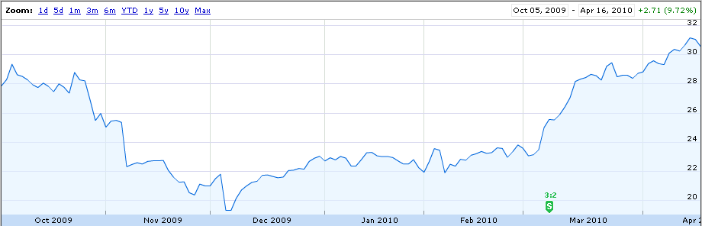
Aeropostale (ARO)
Nov. 20 ($21.24)
Source: Google Finance

Slide 21
Decision Process
Example: Apollo Group (APOL)
Industry still strong
Strong revenue growth (domestic & int’l)
Underpriced (P/E)
But…
  concerns about patterns of ethical issues and regulatory pressure keep the stock price low
Recommendation: SELL

Slide 22
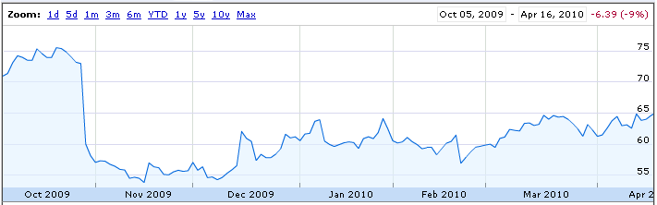
Apollo Group (APOL)
Sold Feb. 5 @ $60.10
Source: Google Finance

Slide 23
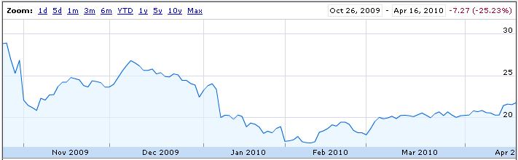
Decision Process
Example: Tessera (TSRA)
Missed Q4 earnings
Litigation Risk
Volatility Concerns
Recommendation: SELL
Sold Jan 21 @ $18.44
Source: Google Finance
Notes:
Bought: 10/26 @ $29.48
Sold: 1/21 @ $18.44

Slide 24
Decision Process
Example: Forest Laboratories (FRX)
& Cephalon (CEPH)
Attractive industry
Healthcare Bill
Cephalon nearing price target
Forest Labs undervalued
Reduced holding in CEPH, bought FRX

Slide 25
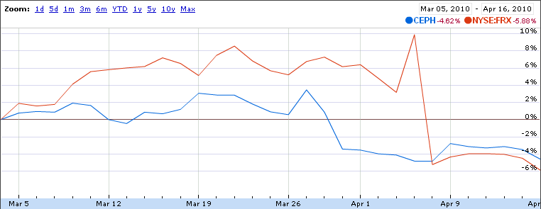
Forest Labs (FRX) & Cephalon (CEPH)
4/7: FDA panel votes against Forest Lab’s Daxas drug
Source: Google Finance

Slide 26
Performance Attribution
Notes:
CIS 512CIS 512
August 26, 2003Monday, November 08, 1999
Copyright - Ajay Vinze 2003©Ajay Vinze
26

Slide 27
Performance Attribution
Equity return: 18.2%
Benchmark return: 17.1%
Alpha: 1.1%
What contributed to the positive alpha?

Slide 28
Performance Attribution
1.1%
Data Source: Fifth Third Asset Management
Notes:
Just for Equities

Slide 29
Allocation Effect
Data Source: Fifth Third Asset Management
* Fund was not invested in sector
Notes:
CIS 512CIS 512
August 26, 2003Monday, November 08, 1999
Copyright - Ajay Vinze 2003Ajay Vinze
29

Slide 30
Selection Effect
Data Source: Fifth Third Asset Management
Notes:
CIS 512CIS 512
August 26, 2003Monday, November 08, 1999
Copyright - Ajay Vinze 2003Ajay Vinze
30

Slide 31
Risk-adjusted Performance
How did the Fund perform on a risk-adjusted basis?
 | SIM Fund | Russell Midcap Growth | S&P 500
Annualized return | 41.96% | 40.51% | 21.57%
Standard deviation | 12.96% | 14.52% | 13.23%
Sharpe Ratio | 3.21 | 2.76 | 1.60
Higher return
+
Lower volatility
=
Higher risk-adjusted performance
Notes:
Sharpe ratio?

Slide 32
Takeaways
Notes:
CIS 512CIS 512
August 26, 2003Monday, November 08, 1999
Copyright - Ajay Vinze 2003©Ajay Vinze
32

Slide 33
Learning Points
Start with an economic outlook
Importance of style selection & allocation
Value of strong fundamentals
Look beyond the numbers
Long-term perspective
ADR reporting issues
Notes:
Apollo had good numbers, but lots of other issues that

Slide 34
Thank You
Thank you to:
  Board of Directors
  Keith Wirtz, Justin Dammel, and Fifth Third
  Jeanne Elliott
  Herb Kaufman

Slide 35
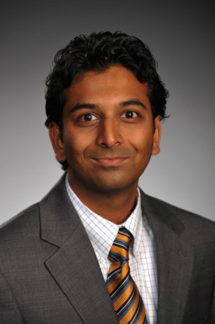
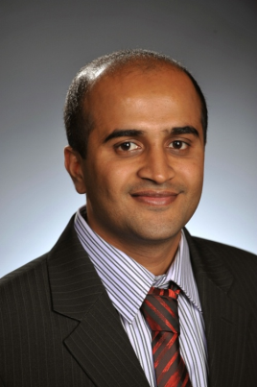


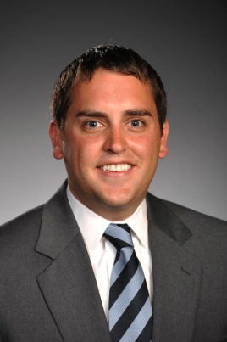



2010-2011 Student Managers
Amol Agarwal
W.P. Carey MBA
Finance
Class of 2011
Praveen Gujar
W.P. Carey MBA
Finance
Class of 2011
Jonathan Kielmeyer
W.P. Carey MBA
Finance & Marketing
Class of 2011
Jameson Bennett
W.P. Carey MBA
Finance & Real Estate
Class of 2011
Andrew Harper
W.P. Carey MBA
Finance
Class of 2011
Andre Shearer
W.P. Carey MBA/MSIM
Finance
Class of 2011
Joe Downs
W.P. Carey MBA
Finance
Class of 2011
Benjamin Hawthorne
W.P. Carey MBA
Finance
Class of 2011
2
Notes:
CIS 512CIS 512
August 26, 2003Monday, November 08, 1999
Copyright - Ajay Vinze 2003©Ajay Vinze
35

