Slide 1

WP Carey
MBA SIM Fund
Board Update
April 25, 2014

Slide 2
Agenda
Introduction
Fund Strategy and Objective
Performance and Attribution
Passive Portfolios
Key Takeaways

Slide 3
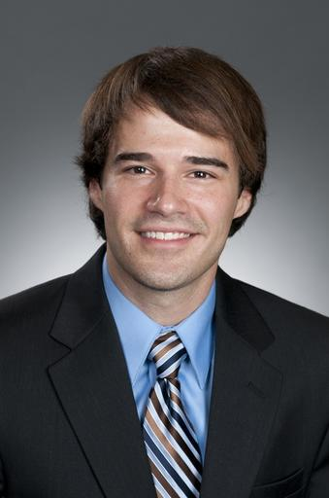
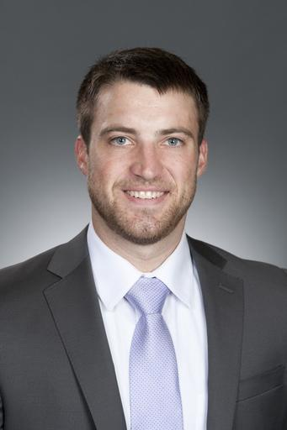
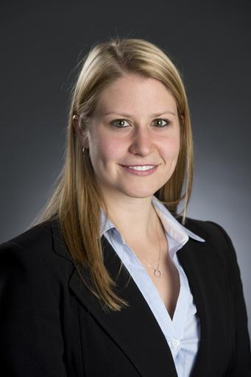
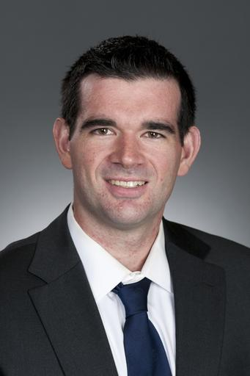

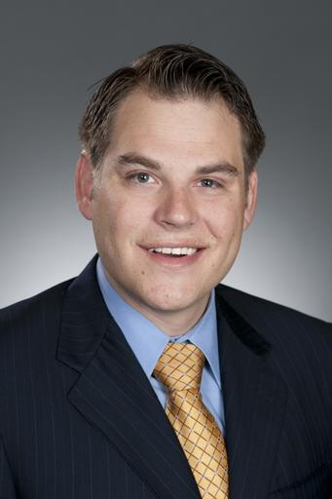
2013-2014 SIM Fund MBA Team
John French
Lucas Hawthorne
Stefanie James
Rob Kane
Greg Miller
Owen Thal

Slide 4
Fund Strategy/Objective
Underlying theory: rates will remain low over the
duration of our investing time frame
Fundamental/Quantitative screening
Bullish outlook
Objectives:
Beat our benchmark (Russell 3000)
Student learning experience
Notes:
Overweight in R.E. (15%) and Commodities (10%)
75% w/in domestic equities

Slide 5
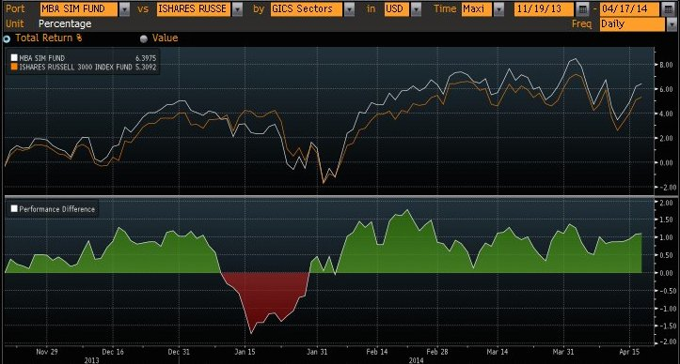
Performance and Attribution

Slide 6
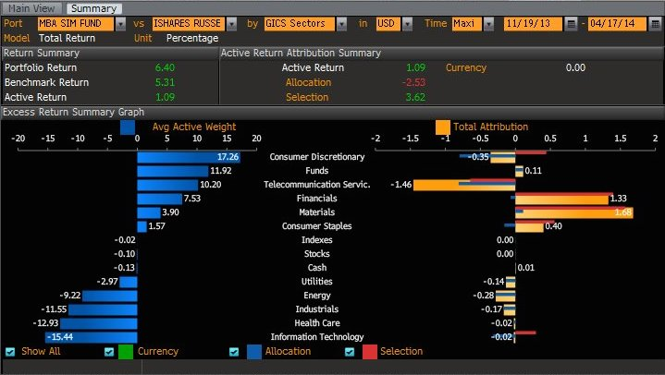
Portfolio Performance

Slide 7
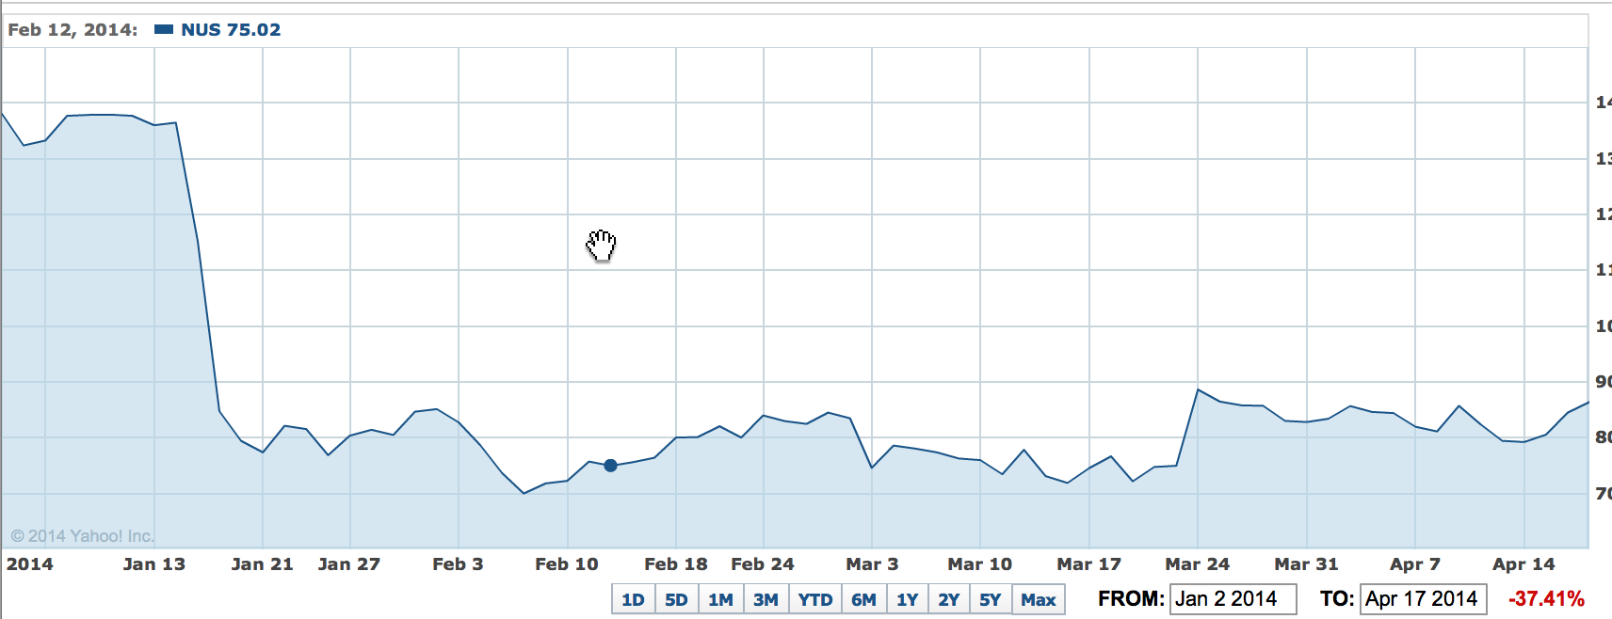
NUS – Nu Skin Enterprises
Decision Dates:
January 28
February 26th

Slide 8
NUS
What to do with a loser?
  Options:
    Double down
    Sell immediately
$115.26 purchase price
  Dropped from $135.83 to $84.40 from Jan 14-16th
  Unforeseen trouble in China
Anticipation of the 4th quarter earnings call

Slide 9
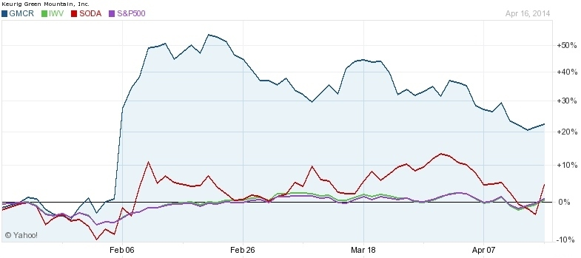
GMCR - Green Mountain Coffee Roasters (Keurig)
Decision Dates:
February 18
March 5th

Slide 10
GMCR
What to do with a winner?
  Options:
    Hold
    Sell immediately
$61.63 purchase price
  Reached $123.46 by Feb 20th with announcement of strategic partnership with Coca Cola
Potential loss of value from indecision

Slide 11
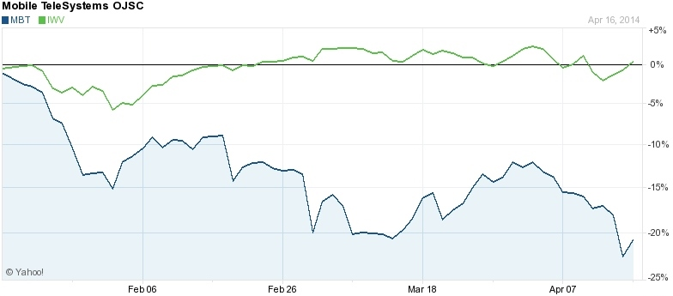
MBT – Mobile Telesystems
January 23th

Slide 12
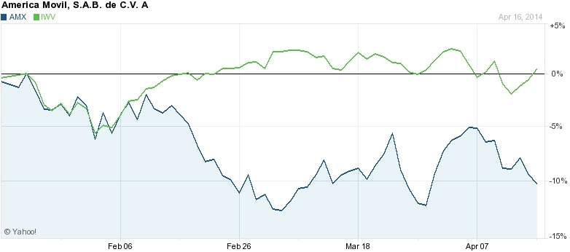
AMX – American Movil
February 26th

Slide 13
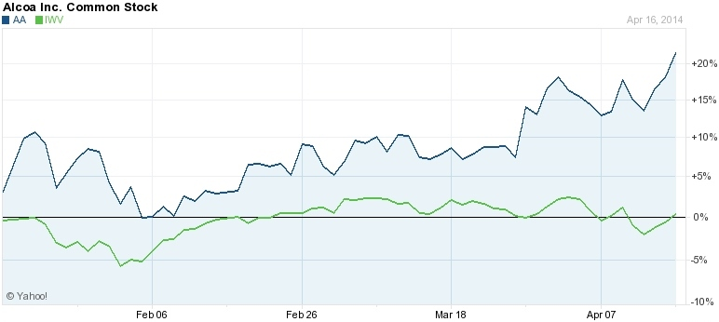
AA – Alcoa, Inc.
March 5th

Slide 14

Trades Not Made
Hindsight is 20/20
  Dodged Bullets
  Missed Opportunities
External Constraints
  Trading Lag
  Charter Limitations
Internal Constraints
  What To Do With Proceeds?
  Majority Decision

Slide 15
Committee Decisions
Must have Majority Decision
  Learning experience: pitching trade ideas
Requirements for Trade
  Data
  Theory
Group Roles and Dynamic
  Influencers
  Skeptics

Slide 16

Stay the Course
New Strategies
  Income via Dividends
  Fed Trade
  Reset, Start Fresh
Hold cash (market timing)

Slide 17
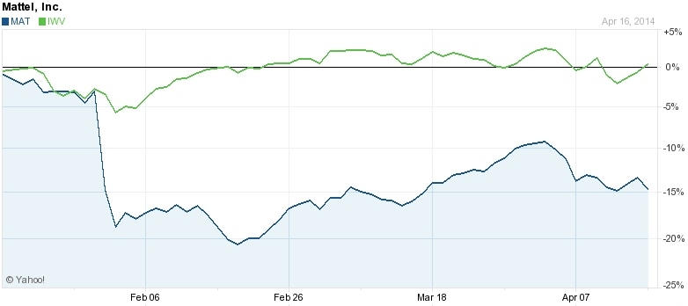
MAT – Mattel
February 14

Slide 18
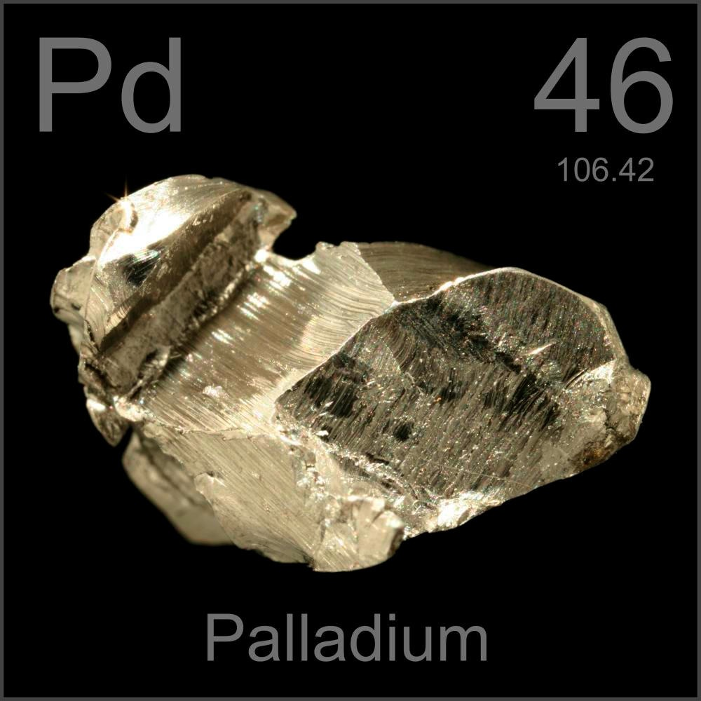
Palladium
Main use today is catalytic converters for cars
Strong demand and limited supply
Price increasing due to:
  Strike in South Africa (37% of world's palladium)
  Sanctions on Russia (the world's largest supplier at 40%)

Slide 19
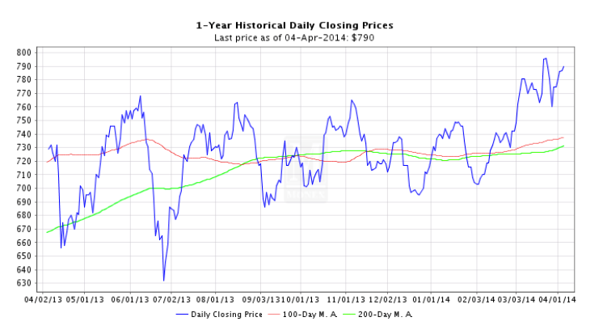
Palladium
Nov 19
Past 6 months:
Commodity – Up 10%
ETFS Physical Palladium - Up 9%
North American Palladium (PAL) - Down 60%

Slide 20
Passive Portfolio Performance
Passive Portfolio
  Returns: 6.61% over benchmark
        1.30% over Russell 3000
        .21% over active portfolio
Alcoa continued to gain after rebalance
On March 24th, Nu Skin was fined less than $.5M by Chinese government resolving uncertainty.

Slide 21
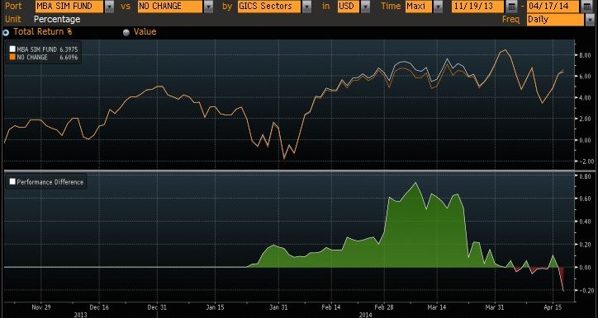
Performance verse Passive Portfolio

Slide 22
Key Takeaways
Portfolio dynamics vs Individual stocks
Tendencies to sell winners and hold losers
No perfect foresight
Time Horizon of the portfolio is important

Slide 23
Questions?

