Slide 1
MBA Student Investment Management Fund
Final Presentation
April 2021
MBA Student Investment Management Fund
1
Arizona State University

Slide 2
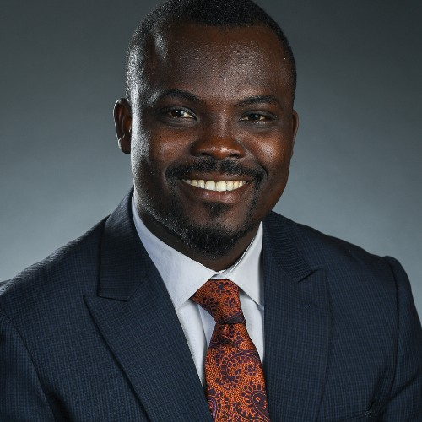
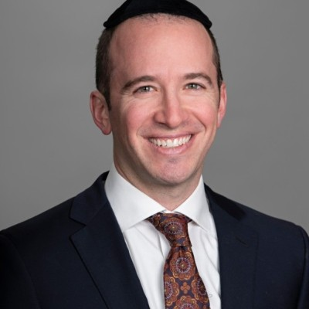
MBA SIM Fund Team
Farrukh Solhail
Festus Olatunde
Aleksey Kim
Makayla Ragnone
Abraham Levy
MBA Student Investment Management Fund
Arizona State University
2

Slide 3
Table of Contents
Investment Thesis and Methods
Exposures
Performance and Attribution
Unusual Security Specific Exceptions
Key Takeaways
MBA Student Investment Management Fund
Arizona State University
3

Slide 4
Investment Thesis and Methods
MBA Student Investment Management Fund
Arizona State University
4

Slide 5
Investment Thesis
Equity of a firm with debt in its capital structure is analogous to a call option written on the assets of the firm
 | High Default Option |  | Low Default Option
Traditional Valuation (e.g. DCF) | Misvalued |  | Appropriate Valuation
Valuation with Default Option | Appropriate Valuation |  | Appropriate Valuation
Eisdorfer, Goyal, and Alexei Zhdanov, 2019, “Equity Misvaluation
and Default Options”, The Journal of Finance 74, 845–898.
MBA Student Investment Management Fund
Arizona State University
5
Notes:
Our investment thesis is built off the research work of Zhdanov and co in 2019. Their work is built on the premise that the equity of a firm with debt in its capital structure is synonymous to buying a call option on the assets of the firm. They sought to find out if the market correctly accounts for this embedded option in valuation. And because holding an option is valuable, they hypothesize that traditional valuation methods do not adequately account for the embedded options component of the firm’s value.
The way went about implementing this strategy was to build a structural model that has the capacity to account for the value of the call option when discounting the future cashflows of the firm. The output of this model is the implied value of the equity. Next, we compare the value of the equity implied by our model to the one we can observe in the market. We then sort the output into deciles and invest in the most undervalued decile.

Slide 6
Portfolio Construction: Inputs & Assumptions
Model Inputs
Current
liabilities
Long-term liabilities
Revenue
Fixed Costs
Volatility
Risk-free rate
COGS
WAAC
CAPEX
Depreciation
Leverage
SIC Code
SG&A
Proxy for fixed costs
Used to calculate industry averages for Depreciation & CAPEX
SIC Codes
Return on Assets
Equals WACC
Model Equity Value
MBA Student Investment Management Fund
Arizona State University
6
Notes:
Now I would like to talk about some inputs and assumptions that went into the algorithms to generate our valuation. The inputs include financial information extracted from Bloomberg including Liabilities, Fixed Cost, WACC, Capex data etc.. One thing to point out is that we considered SG&A to be the fixed costs of the firm needed by the model. Similarly ROA was considered equal to WACC. The output of the model was the model equity value which we used to calculate the valuation ratios. So as Festus mentioned before we divided the model value with current market cap to find the ratio. If the ratio was above 1 the firm was undervalued, and if it is below 1 it is overvalued.

Slide 7
Exposures
MBA Student Investment Management Fund
Arizona State University
7

Slide 8
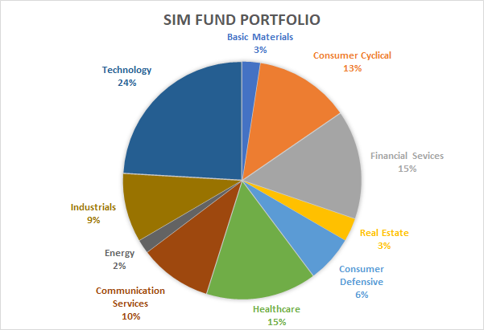
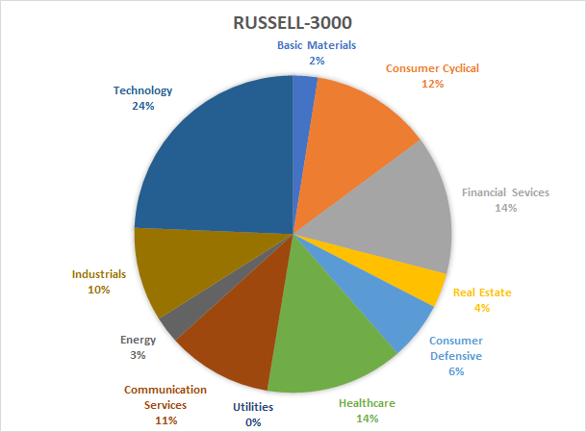
Sector Weighting Comparison - April 2021
MBA Student Investment Management Fund
Arizona State University
8
Notes:
This shows our portfolio in comparison to the Russel-3000. Our aim was to distribute the sector weights in out portfolio as close as possible to the Russell-3000.

Slide 9
Sector Weighting Comparison - April 2021
Asset | Russell 3000 | Portfolio | Number of Stocks | Allocation per equity | Average Market Cap
Basic Materials | 2.44% | 2.31% | 3 | 0.8% | $2.7B
Consumer Cyclical | 12.05% | 11.62% | 12 | 1.0% | $2.7B
Financial Services | 12.47% | 12.03% | 11 | 1.1% | $2.5B
Consumer Defensive | 6.76% | 6.51% | 7 | 0.9% | $2.6B
Healthcare | 14.45% | 13.92% | 6 | 2.3% | $2.1B
Communication Services | 10.51% | 10.13% | 5 | 2.0% | $2.9B
Energy | 1.91% | 1.81% | 3 | 0.6% | $1.7B
Industrials | 9.15% | 8.82% | 9 | 1.0% | $3.3B
Technology | 23.70% | 22.84% | 13 | 1.9% | $2.4B
MBA Student Investment Management Fund
Arizona State University
9
Notes:
At this point in time we were not able to seed the portfolio due to challenges that we faced in the Covid environment. We are on schedule to seed the portfolio as per our plan in this presentation on Monday next week.

Slide 10
Performance and Attribution
MBA Student Investment Management Fund
Arizona State University
10

Slide 11
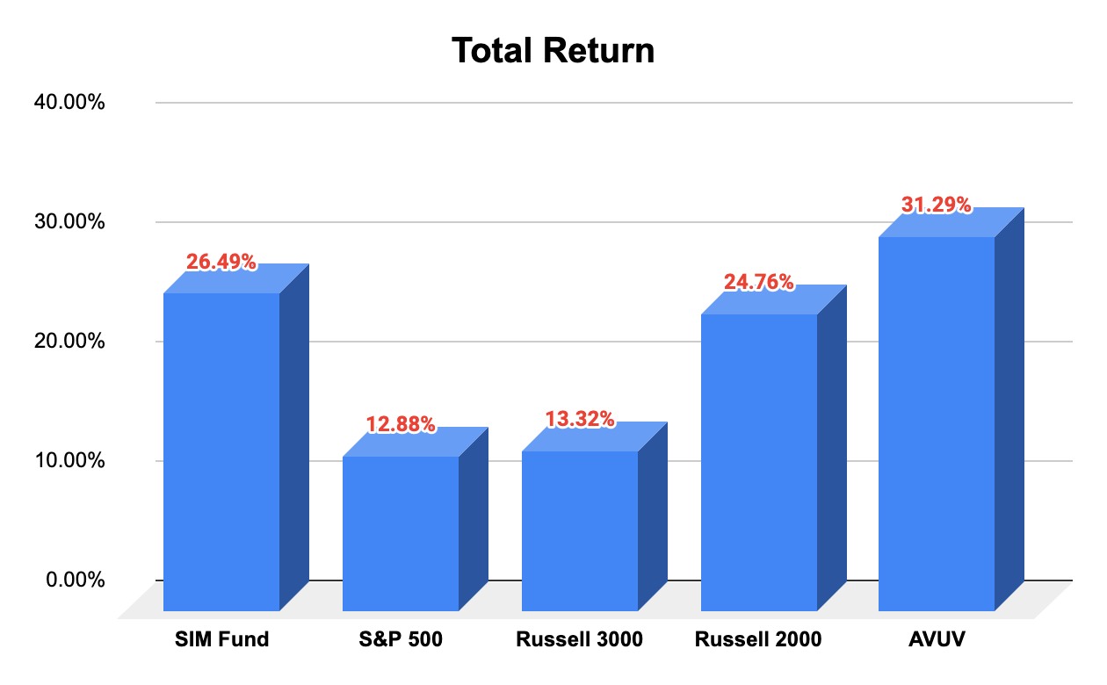
Performance
MBA Student Investment Management Fund
Arizona State University
11
Notes:
Performance
Thank you Festus
Every week we ran performance and attribution on our portfolio
We analyzed total returns and compared it against the Russell 2000, Russell 3000, S&P 500 and AVUV also knows as Avantis, a small cap value fund
The reason We compared it to the The Russell 3000 because that is our “official” benchmark so it is useful to look at performance relative to that.
We looked at the S&P 500 because it is a common large cap benchmark.
We used the R2000 because we have a clear size tilt in our portfolio towards small cap
And AVUV was useful to look at because it is similar in both size and value to our tilt.
Our portfolio realized 26.49% return since seeding the fund on December 9th 2020
Over the same time horizon:
the S&P realized a 12.88% return
the Russell 3000 realized a 13.32% return
the Russell 2000 realized a 24.76% return
and AVUV realizing a 31.29% return
Now that we've had a chance to talk about the returns, we'll know discuss some of the attribution both in terms of size and sector.

Slide 12
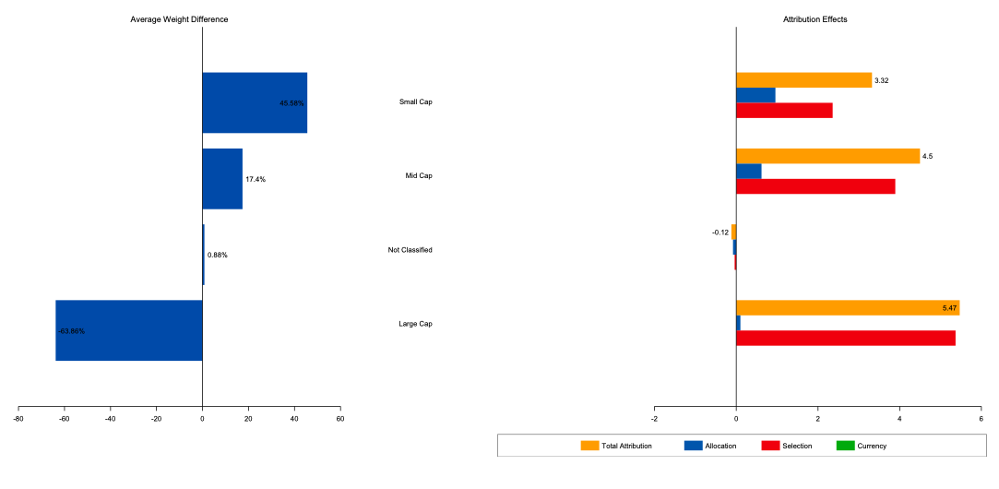
Market Cap Attribution - Russell 3000
MBA Student Investment Management Fund
Arizona State University
12
Notes:
Market Cap Attribution - Russell 3000
Lets look at size first
In relation to the Russell 3000, our portfollio is underweight large caps and overweight small caps
Considering that small caps did better over this time period we benefit from the allocation to small caps

Slide 13
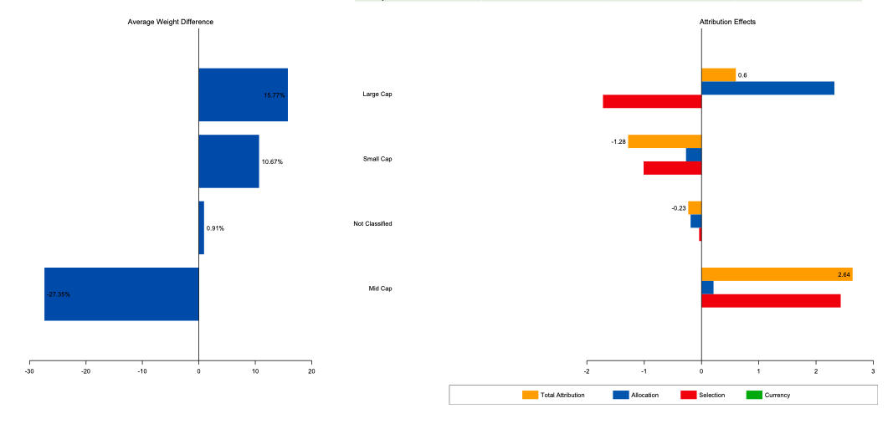
Market Cap Attribution - Russell 2000
MBA Student Investment Management Fund
Arizona State University
13
Notes:
Market Cap Attribution - Russell 2000
In comparison to the Russell 2ooo, we have a little bit of allocation to large caps in our portfollio which is why we're larger than the R2 which doesnt have any large caps
The difference for small caps is not as sharp as in the R3 but as we mentioned in the previous slide we benefit from the allocation to small caps

Slide 14
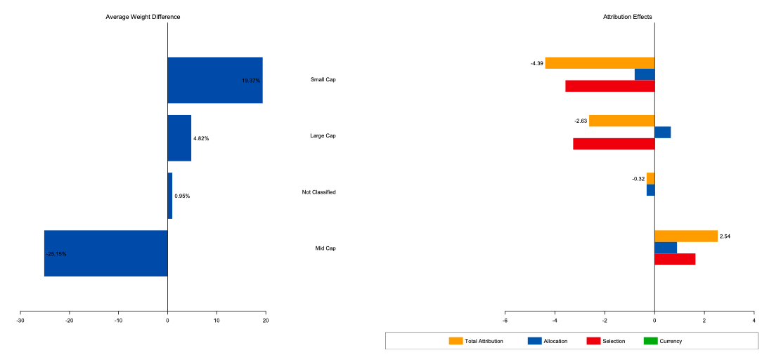
Market Cap Attribution - AVUV
MBA Student Investment Management Fund
Arizona State University
14
Notes:
Market Cap Attribution - AVUV
As you can see we have a larger allocation to small caps than AVUV does
we hold more small cap securties than AVUV which is why the attiribution is positive as it relates to small caps, but the effects in terms of actual returns is slightly negative caused by selection

Slide 15
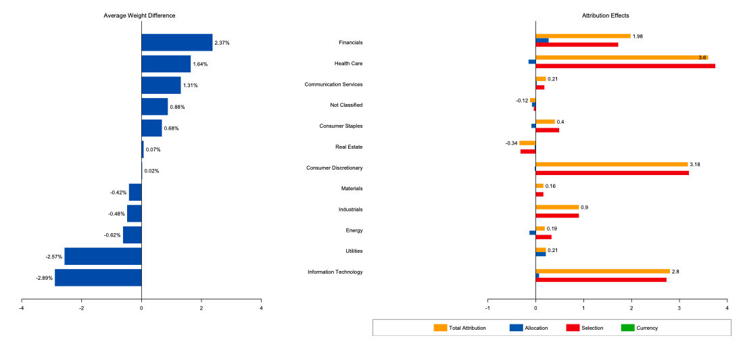
Sector Attribution - Russell 3000
MBA Student Investment Management Fund
Arizona State University
15
Notes:
Sector Allocation - Russell 3000
We have some slight weight variation with respect to the R3
There are some selection effects here in financials, health care, communications services, consumer discretionary, and information technology on the positive side
and real estate on the negative side

Slide 16
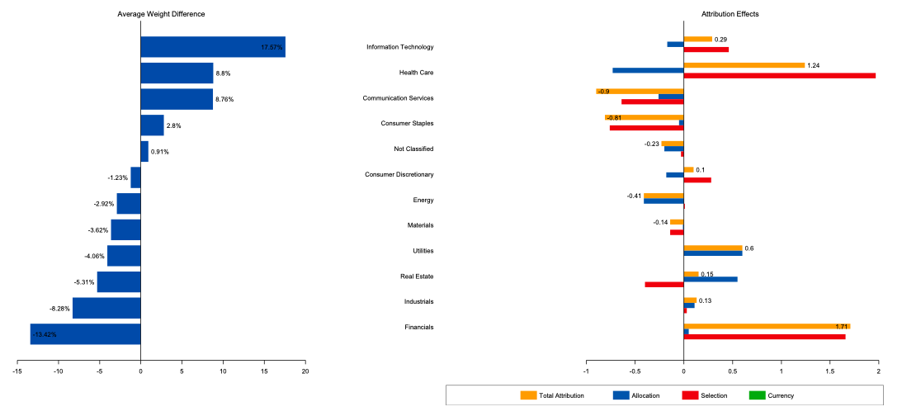
Sector Attribution - Russell 2000
MBA Student Investment Management Fund
Arizona State University
16
Notes:
Sector Attribution - Russell 2000
We start to see slightly larger variation in sector weights in comparison to the R2
And you can see there are some selection effects here as well,
Health care and financials on the positive side
and Consumer staples and communication services on the negative side

Slide 17
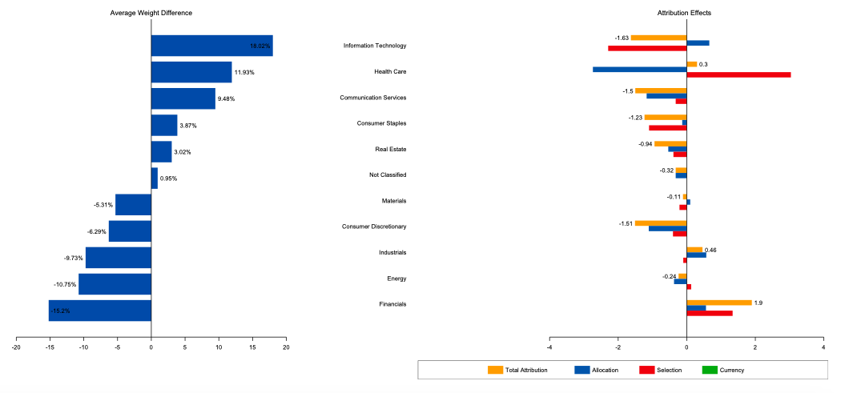
Sector Attribution - AVUV
MBA Student Investment Management Fund
Arizona State University
17
Notes:
Sector Attribution - AVUV
Similar story by AVUV as well; however, the variances are even bigger and that again, is because in constructing our portfolio we tried to be sector neutral with respect to the R3 not with small cap value
We have selection effects here caused by health care and financials on the positive side
and information technology and consumer staples on the negative side
Ill know pass it back over the Festus who will walk us through some of the Unusual Activity and Security Specific Exceptions that we encountered

Slide 18
Unusual Security Specific Exceptions
MBA Student Investment Management Fund
Arizona State University
18

Slide 19
Unusual Activity/Security Specific Exceptions
Archegos Capital Management/Viacom
Held Both VIACA and VIAC
Sold Off in Droves - Recoup a Fraction of the Losses
Heavily Affected our Communications Allocations
We Decided to Hold
Results to Date
MBA Student Investment Management Fund
Arizona State University
19

Slide 20
Key Takeaways
MBA Student Investment Management Fund
Arizona State University
20

Slide 21
Key Takeaways
Investment Management Process
Tested Out the Investment Hypothesis
Implementation of Investment Model
Understanding of Limitations
Address Challenges in Investment Management
MBA Student Investment Management Fund
Arizona State University
21

Slide 22
Thank You!
Questions?
MBA Student Investment Management Fund
22
Arizona State University

Slide 23
Unusual Activity/Security Specific Exceptions
Viacom
Oversight
Prices now VIACA ($46.04) and VIAC ($41.11)
VIACA (Class A Shares)-Voting Shares
VIAC (Class B Shares)-Nonvoting Shares
Holding both doubled our company specific exposure
MBA Student Investment Management Fund
Arizona State University
23

Slide 24
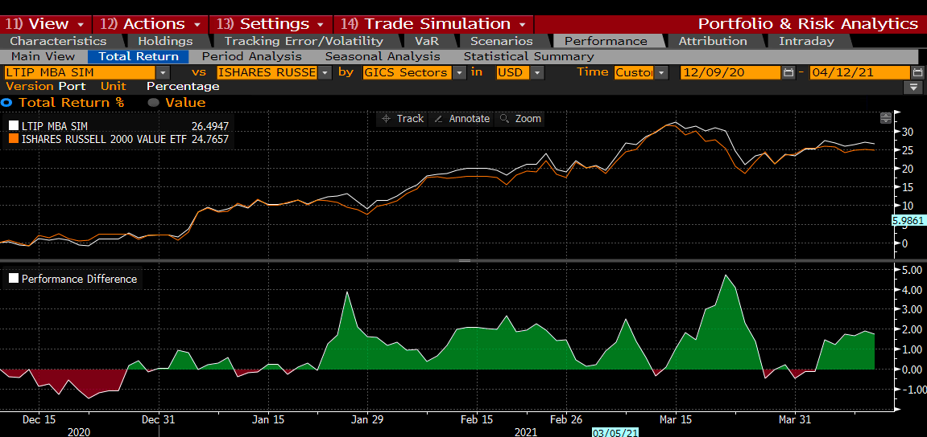
Performance & Attribution
Seed Date: 12/9/2020
Notes:
Every week we ran performance and attribution on our portfolio
We analyzed total returns and used the Russell 2000, Russell 3000 and AVUV also knows as Avantis US Small Cap Value ETF as benchmarks
We started doing comparative analysis to Avantis, which is a small cap value fund, towards the end of February because AVUV has similiar sector distribution as our portfolio and we were looking to get a more realistic comparison to our holdings

Slide 25
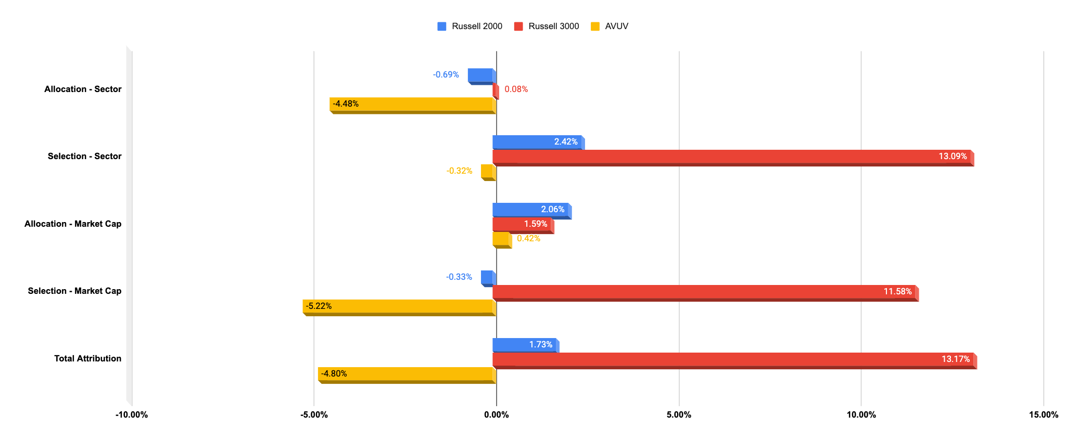
Attribution

Slide 26
Performance - Russell 3000

Slide 27
Performance - Russell 2000

Slide 28
Performance - AVUV

Slide 29
